Slide 1
EPAF TRAINING
Electronic Personnel Action Forms
Danielle Archuleta
615-898-2382

Slide 2
EPAF overview
The Electronic Personnel Action Form allows paperless processing of personnel actions for Students, Temp Hourly, Graduate Assistants, and Adjunct Faculty employees.
This process enables MTSU to expedite personnel actions through an electronic approval process and provides an audit trail of approval/disapproval history for all processes applicable to part time non-benefitted employees.
The EPAF is originated in the department by the individual who is authorized to generate payroll transactions. Once the EPAF is created, it is saved and submitted through an electronic approval routing queue. Each EPAF has mandatory approval levels developed by the Human Resource Services office.

Slide 3
Student epaf categories
HIRING STUDENT EPAF TYPES:
HIREST – Used to process student who have never worked in the position before.
HIRESW – Used ONLY by Financial Aid to process new work study positions.
GRHIST – Used to process student in grant positions who have never worked in that position before.
TAFHIR – Used to process individuals in TAF positions.

Slide 4
REHIRE STUDENT EPAF TYPES:
REHIST – Used when a student has previously worked in a position.
REHISW – Used ONLY by Financial Aid to re-hire a work study student.
GRRHST – Used to re-hire a student into a grant position that they have previously worked in.
TAFRAT – Used to re-hire an individual into a TAF position
TERMINATION EPAF TYPES:
TERMST – Used to end a position for a student worker.
TERMSW – Used ONLY by Financial Aid to end a work study position.
TERMTA – Used to terminate a TAF Position

Slide 5
OTHER STUDENT EPAF TYPES: RATE CHANGE
RATEST – Used to change a pay rate on a student position.
GRRATE – Used to change a pay rate on a student in a grant position.
TAFRAT – Used to change a pay rate on a TAF position.
T-ORG CHANGE
TORGST – Used to change a T-Org on a position for a student worker.
TORGSW – Used ONLY by Financial Aid to change a T-Org on a work study position.
GRTORG – Used to change a T-Org on a grant funded student position.
TAFTOR – Used to change a T-Org on a TAF position.

Slide 6
STUDENT EPAF APPROVALS
REQUIRED APPROVAL LEVELS FOR STUDENTS
PI – Principal Investigator – only for Grant Related EPAF’s.
RS – Research Services – only for Grant Related EPAF’s
DEPTHD – Department Head must approve all EPAF’s
HRAPP – Human Resource Services verifies and applies all EPAF’s
Department Head’s may designate a Proxy Approver for EPAF’s through their Pipeline account

Slide 7
TEMP HOURLY EPAF CATEGORIES
HIRETH – Used to hire temp hourly in a new position.
REHITH – Used to re-hire temp hourly in a previous position.
TERMTH – Used to end a temporary hourly position.
RATETH – Used to change pay rate for TH position
TORGTH – Used to change T-org for temp hourly
GRHITH – Grant Hire in a new position
GRRHTH – Grant Rehire in a previous position
GRRTTH – Grant pay rate change for Temp Hourly position.

Slide 8
TEMP HOURLY APPROVALS
REQUIRED APPROVAL LEVEL FOR TEMP HOURLY EMPLOYEES
HR Approve Transaction – (NEXGEN) –the EPAF will hold here until the employee has electronically signed their contract. Once signed, the NEXGEN approval will process and move the EPAF to the next approver.
DEPT HD
VICE PRESIDENT
HR APPLIER –(MHRW00001) allows contract to be applied to Banner and sets up job record.
GRANTS - EPAF’s will require approval from Research Services and PI
Department Head’s may designate a Proxy Approver for EPAF’s through their Pipeline account

Slide 9
GRADUATE ASSISTANT EPAFS
EPAF CATEGORIES:
GAAS09 – Hire GA position – 9 month
GAAS12 – Hire GA position – 12 month
GAASDR– Hire GA Position – Doctoral
RHGA09 – Rehire GA position – 9 month
RHGA12 – Rehire GA position – 12 month
RHGADR– Rehire GA Position – Doctoral
GGAH09 – Grant Hire – GA position – 9 month
GGAH12 – Grant Hire – GA position – 12 month
GGAHDR – Grant Hire – GA position – Doctoral
GGRH09 – Grant Rehire – GA position – 9 month
GGRH12 – Grant Rehire – GA position – 12 month
GGRHDR – Grant Rehire – GA position – Doctoral

Slide 10
GA APPROVALS
REQUIRED APPROVAL LEVEL FOR GAs
HR Approve Transaction – (NEXGEN) –the EPAF will hold here until the employee has electronically signed their contract. Once signed, the NEXGEN approval will process and move the EPAF to the next approver.
DEPT HD
PI & Research Services (if grant position)
GRADIN – Initial review Grad Studies
GRADSC – Graduate Studies
HR APPLIER –(MHRW00001) allows contract to be applied to Banner and sets up job record.
Department Head’s may designate a Proxy Approver for EPAF’s through their Pipeline account

Slide 11
Adjunct faculty epaf teaching
A Teaching EPAF will have credit hours attached!
HIREAF – used when the individual has NEVER worked in the position number.
REHIAF – used when the individual HAS worked in the position number.
GRHIAF – used for grant position numbers and individual has never worked in the position number before.
GRRHAF – used for grant position numbers and individual has previously worked in the position number.
TERMAF – used to terminate a position number.

Slide 12
Adjunct faculty epaf non-teaching
Non-Teaching EPAF will have clock hours associated with payment.
AFHINT – used for an individual who has NEVER worked in position number before.
AFRHNT – used for an individual who HAS worked in position number.
AFGHNT – used for a grant position when the individual has never worked in position before.
AFGRNT – used for a grant position when the individual has worked in position before.
TERMAF – used to terminate an adjunct position.

Slide 13
Adjunct approvals
Mandatory Approval Levels
HRAPR – The EPAF is awaiting the employee electronic signature. Once signed, HR will push the EPAF forward for approvals.
PI & Research Services (if grant position)
DEPTHD – Chair/Director, etc.
DEANS – Applicable College Dean.
ACADRE – Academic Affairs review and approval.
VP – Applicable Vice President.
HRAPP – Human Resource Services applies all EPAFs.
Any approver may designate a Proxy Approver for EPAF’s.

Slide 14
Academic affairs requirements
The University Provost Office (Academic Affairs) requires additional steps be completed prior to appointments. EPAFs will not be approved until All required documentation is received. This includes:
Academic Preparation Certification (SACSCOC) Form
Curriculum Vita
Three current professional letters of recommendation
Official transcripts for all degrees
Background check – sent electronically to Lynn.sewak@mtsu.edu
Re-Hiring Adjunct – must submit Academic Preparation Certification (SACSCOC) form.

Slide 15
Creating epafs
Before you create an EPAF:
Employee’s M# / Banner ID
Position Number
Date of Action(s)
Rate of pay
T-org
NOTE: Be familiar with EPAF types – it makes a difference!

Slide 16
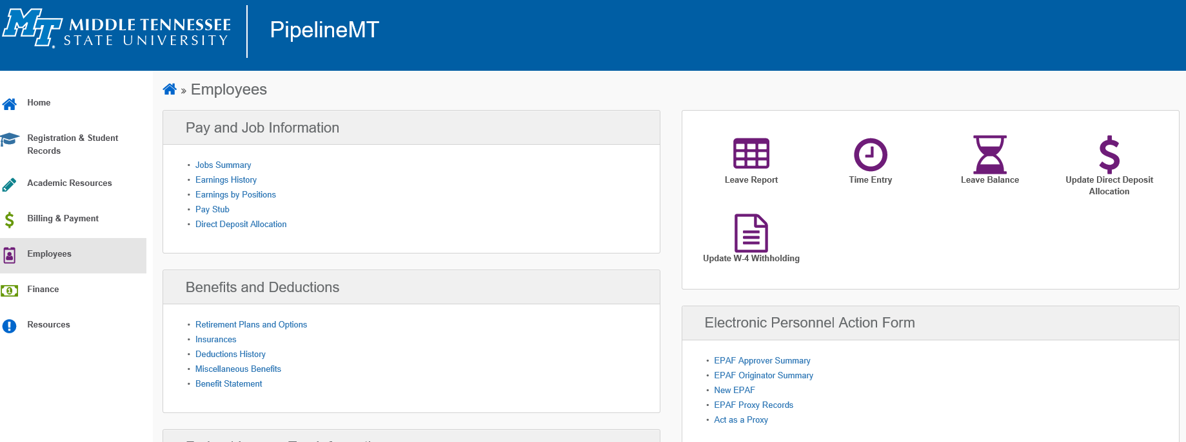
Log into Pipeline, click on Employee tab, and then click “New EPAF” link

Slide 17
Enter the Banner ID (M number), hit tab, and verify correct name
Query Date – this date should be the date of the event. It will default to today’s date, but it’s best to change it to the event date. YOU CANNOT USE AN EVENT DATE PRIOR TO THE DATE AUTHORIZED BY HR TO BEGIN WORK. If someone started working prior to that date, contact HR.
Under “Approval Category” use the drop down and select your EPAF and click “Go”
1
2
4
3

Slide 18
You will now see the section related to job information for the individual. If you are using a HIRE EPAF, you will enter data in the “New Job” section. You will enter the position number and suffix “00” for a new position and click “go”
If the individual has worked in position before, you will see the positions displayed. If you are using an existing position, you must select a rehire EPAF.

Slide 19
If you are using a Re-Hire EPAF, you would select the position you are re-hiring the individual into by clicking the radio button on the right.
If you are using a hire EPAF and see the position already listed, you must go back and select a rehire EPAF.
You would then click “go”
PLEASE NOTE: YOU WILL BE ABLE TO SEE THE PREVIOUS T-ORG AND PAY RATE USED FOR THIS POSTION AND CAN CHANGE IT IN THE NEXT SCREEN IF NEEDED.

Slide 20
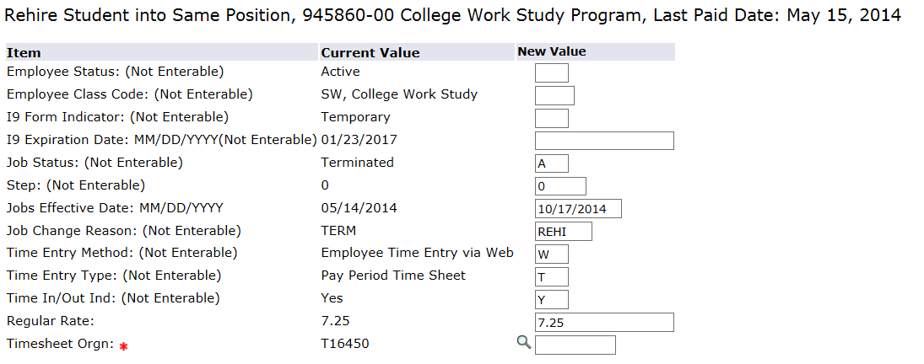
The T-Org must be entered or you will not be able to submit. PLEASE NOTE: IF “T” IS NOT ENTERED A TIME SHEET WILL NOT BE GENERATED
The search icon is not active for T-org’s
You can change the Job Effective Date and Pay Rate if you choose.

Slide 21
The Routing Queue’s must be entered or you will not be able to submit your EPAF.
Use the search icon (magnifying glass) to find the correct user name for your approver.
Additional box will pop up for you to select your approver.

Slide 22
Once you have entered your approvers, you will click on the “save” button at the bottom.
At the top of the page, you will see a green check if your EPAF was saved successfully. If so, then click “Submit” to submit the EPAF for approval.

Slide 23
You will see at the top if your EPAF was successfully submitted.
You will also see just below that, the “Errors and Warning Message” displays. Warning messages will not stop and EPAF from going through. Errors will stop the EPAF from going through
The warning message above will always be displayed. Disregard!

Slide 24
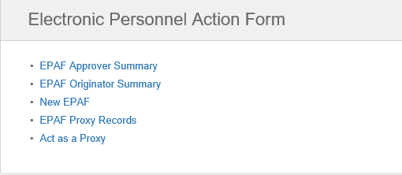
To review the status of an EPAF, the originator can log into Pipeline and under the “EPAF Originator Summary” link they can review EPAF actions:
Under “Transaction Status” you can select for review. Current tab will show EPAFs waiting, History will show EPAFs that have been submitted:

Slide 25
Tracking EPAFs is the responsibility of the originator.
To review an EPAF, you select the individual and you will be able to review the entire EPAF.

Slide 26
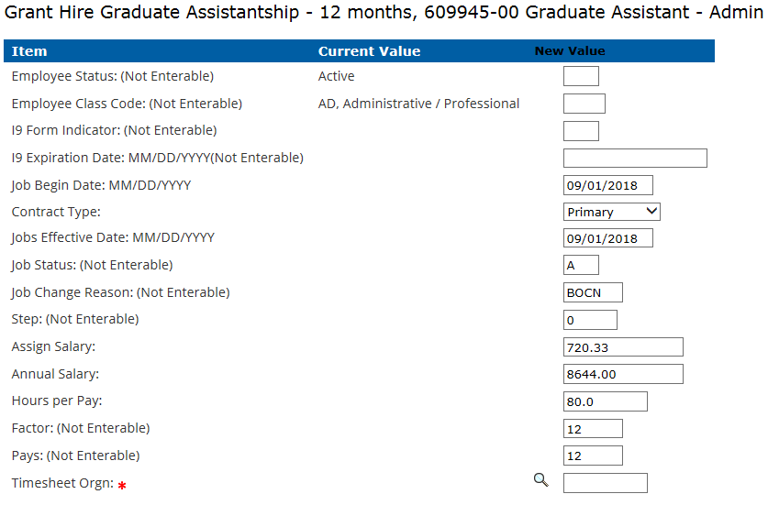
Graduate assistant epaf
How are GA EPAFs Different?
The job begin and the assign salary will populate as will the annual salary and hours per pay based on the EPAF type you select!

Slide 27
If the assistantship is less than full-time, you must manually change the assign salary, the annual salary, and the hours per pay.
Half-time graduate assistant hours per pay are 40.0 and full-time are 80.0.

Slide 28
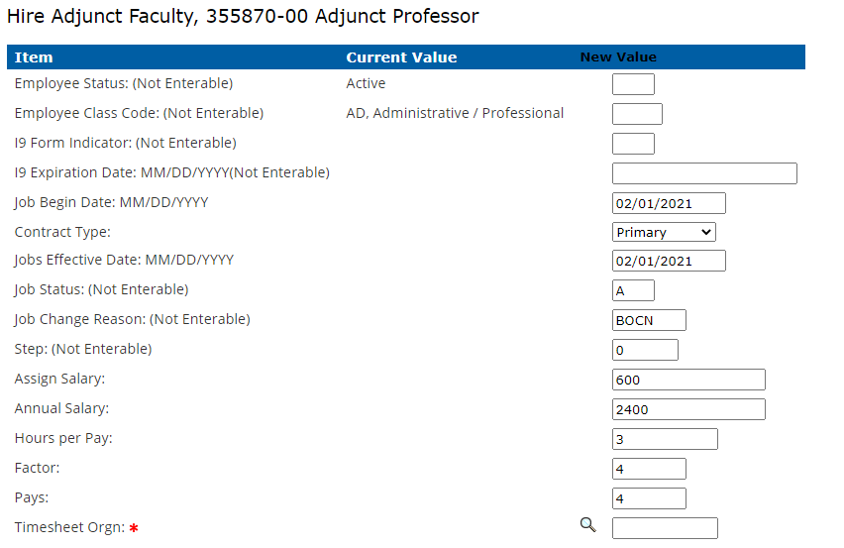
Adjunct epaf
For both hire and rehire Adjunct EPAFs, the Assign Salary, Annual Salary, Hours per Pay, Factor and Pays will default:

Slide 29
Certain fields are enterable and can be changed. The Assign Salary x Factor = Annual Salary. If you change one, you must change the other. If you are changing the number of payments (Pays), you must change the factor as well:
The “Hours Per Pay” field is the credit hours the individual is being paid for, ex: 3 credit hours, 6 credit hours, etc. The credit hours are converted to clock hours by HR for ACA reporting purposes.

Slide 30
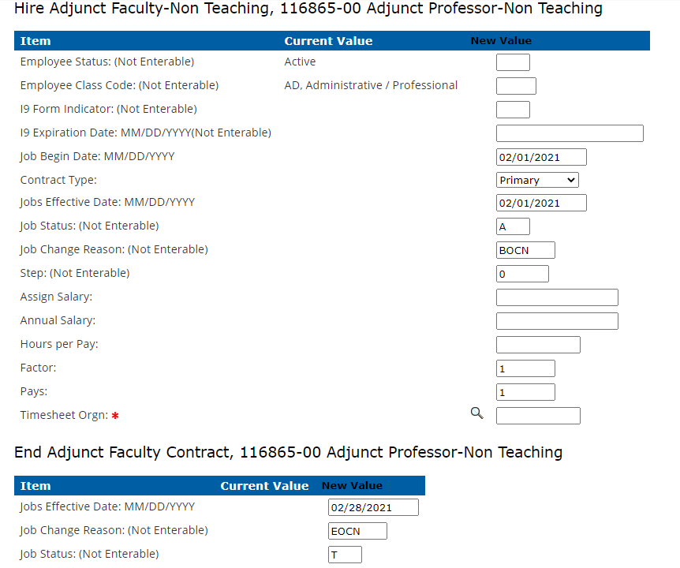
Non-teaching adjunct epaf
Typically used when processing one-time payment for services other than teaching known as flat rate or Non-Teaching rate. These positions usually end in 865. The job effective date and end date will default in and must be updated to reflect the upcoming payroll period.

Slide 31
Adjunct calculations
The Assign Salary, Annual Salary, Hours Per Pay and Timesheet Orgn code must be entered.
Assign Salary = the total amount to be paid.
Annual Salary = the assign salary x factor
Hours per Pay = the total number of clock hours expected for payment. If more than one payment, divide hours by number of payments. Example: 100 hours for 2 months = 50 hours per pay.
Pays = the number of payments to be made at the assign salary rate. If there are multiple payments, the factor and pays must equal. Example: 2 payments of $500.00 = Assign salary $500.00, Factor = 2. Pays = 2, Annual Salary $1,000.00.

Slide 32
Electronic contracts
Once the EPAF has been successfully submitted, the individual will be sent a link to electronically sign the contract.
Temp hourly, Graduate Assistants, and Adjunct Faculty employees, must agree to the terms and conditions of the contract electronically.
HR will verify that the contract has been electronically signed and kick off the EPAF for approvals.
After the EPAF has been approved, it will be applied by HR and the job record will be created. A timesheet will also populate if applicable.
Temp hourly assignments are not required to have end dates, but GA and AF assignments will automatically default start and end dates.

Slide 33
New temp hourly, GA, or AF employees will have to wait 24 – 48 hours before signing their contracts electronically. The ability to click the link and sign their contract depends on their MTSU email being set up and active. It takes at least 24 hours before ITD can run the process to activate a new MTSU email.
If you are the originator of an EPAF, you cannot be the department head approver. This will cause the EPAF to error.
The contract is sent to the email listed on the Workflow. Therefore, Workflow must be completed first.

Slide 34
troubleshooting
Have you done the Hiring Verification in Workflow?
If not, you have to do so before creating an EPAF to ensure all employment paperwork is up to date or received by HR. The EPAF will not process if this paperwork has not been submitted.
Is the type of EPAF you selected correct?
The type of EPAF you select is critical for payroll processing. Also, EPAF’s contract type defaults to “secondary”, if this person does not have another job change to “primary”.
Has your EPAF been approved?
A e-mail is sent to the approver when an EPAF is pending approval. Please approve ASAP. The employee’s pay depends on it!

Slide 35
Adjunct additional info
A Hiring Verification Workflow must be processed first, before the individual can begin working.
There are separate position numbers for teaching, non-teaching, and accelerated assignments. Please ensure you are using the correct position number.
For Teaching positions, credit hours entered on the EPAF would be the same entry made currently on the paper Personnel Appointment Form (PAF).
The contract dates and rate of pay will automatically default for Adjunct EPAFs.
If a position must be terminated outside of the normal contract, HR must be contacted prior to submitting a TERMAF EPAF so that any future dates can be removed.

Slide 36
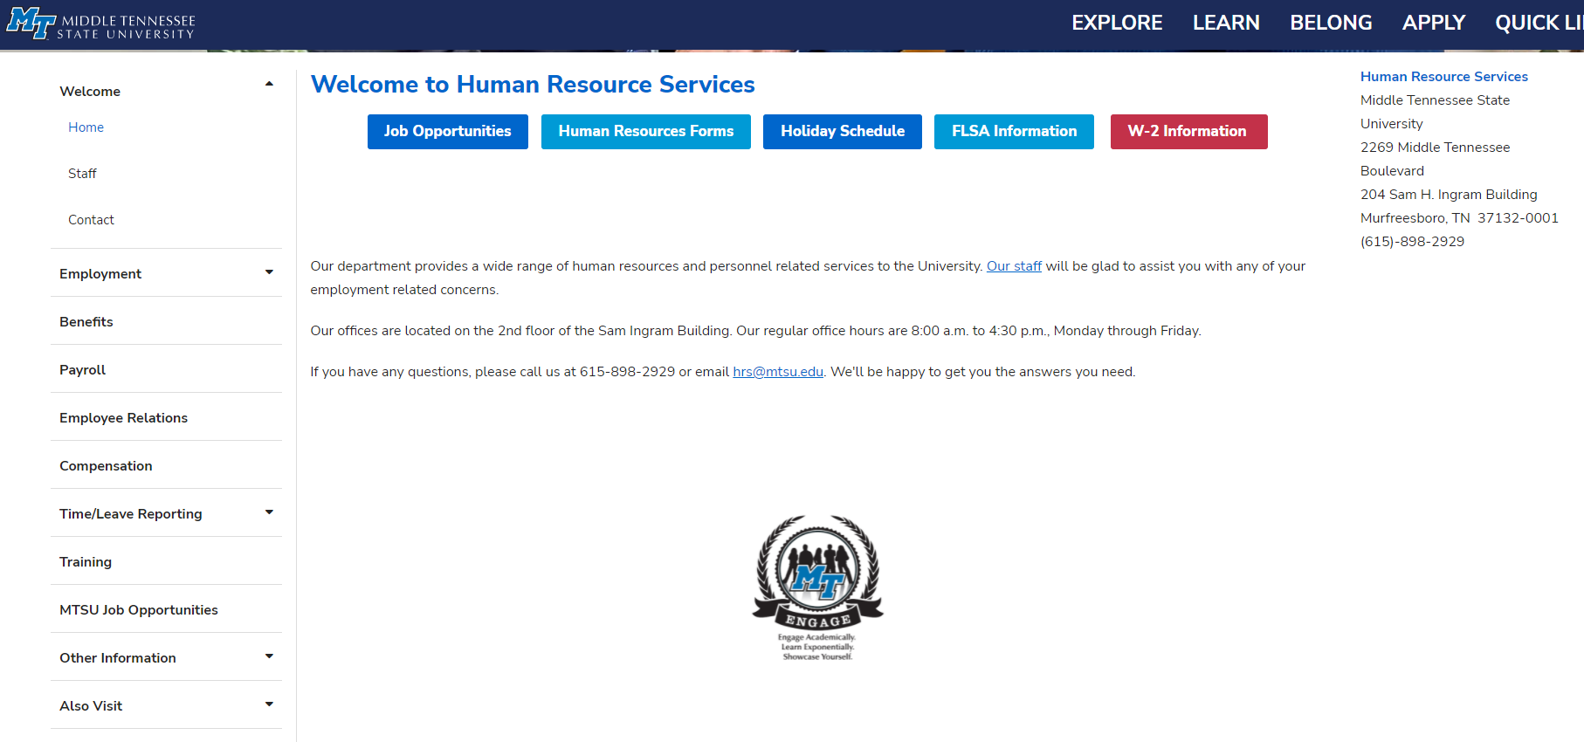

Slide 37
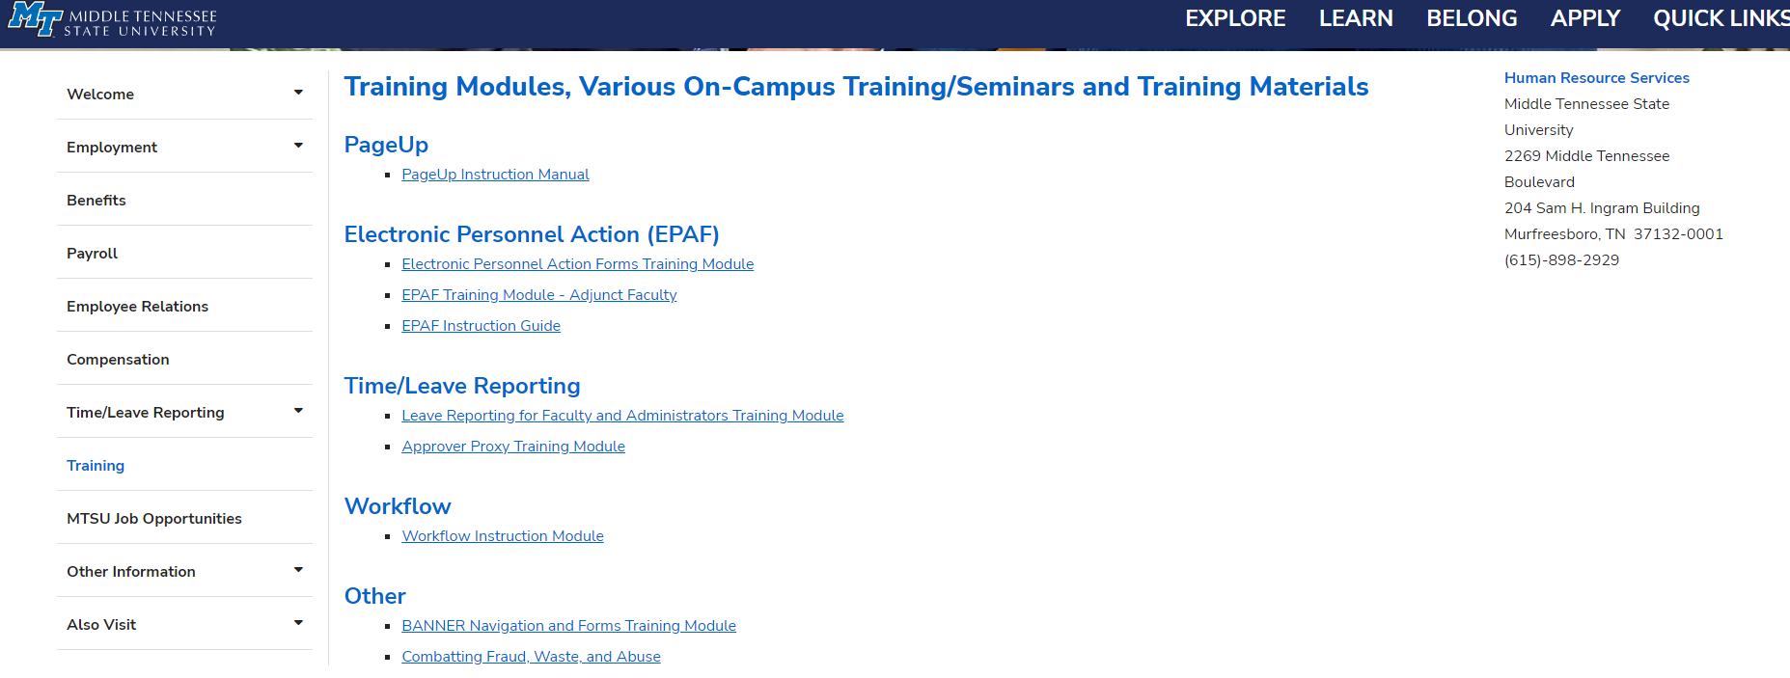

Slide 38
Epaf processing
Still having trouble processing your EPAF?
Danielle Archuleta – x2382
Danielle.Archuleta@mtsu.edu
Thank you for attending!

